Slide 1

Marques, Right or Wrong:
A Sample Presentation for
ENGL 135 at DeVry University
Geoffrey B. Elliott, PhD
geoffrey.b.elliott@gmail.com
http://www.elliottrwi.com

Slide 2
Overview
Summary of Marques (2019)
Pathos and Logos in Marques (2019)
Ethos in Marques (2019)
A Counterargument to Marques (2019)
Another Counterargument to Marques (2019)
Hopeful Implications of Marques (2019)
Conclusion
References

Slide 3
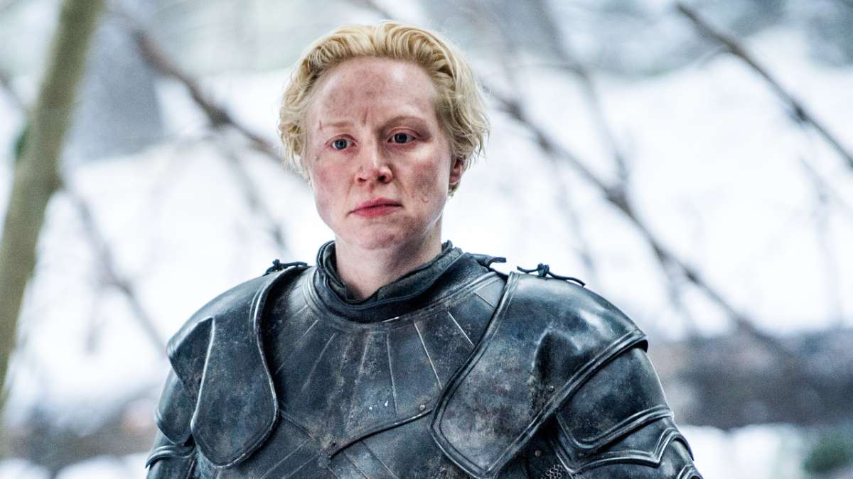
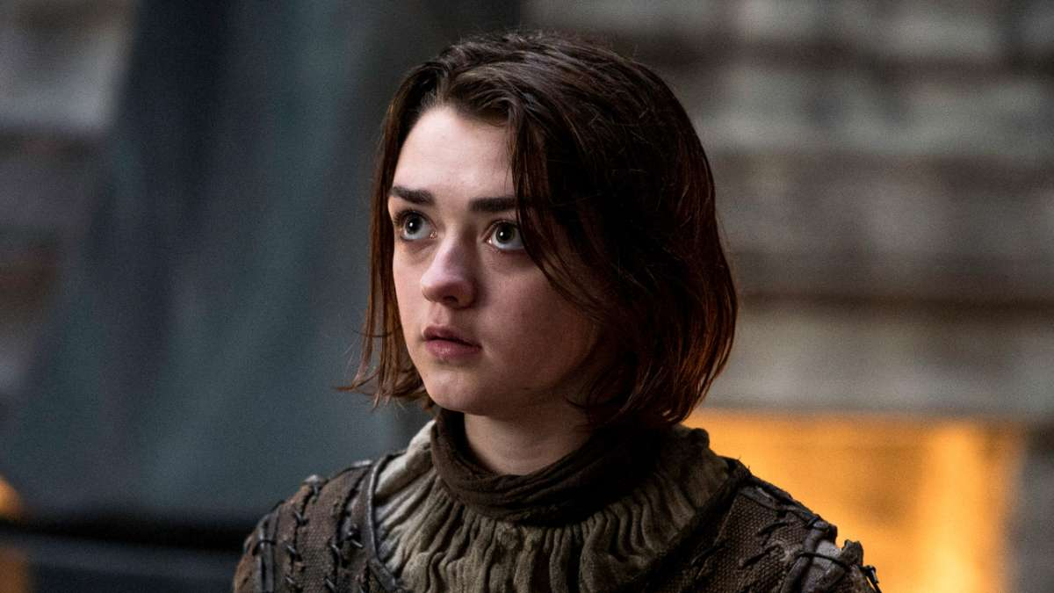
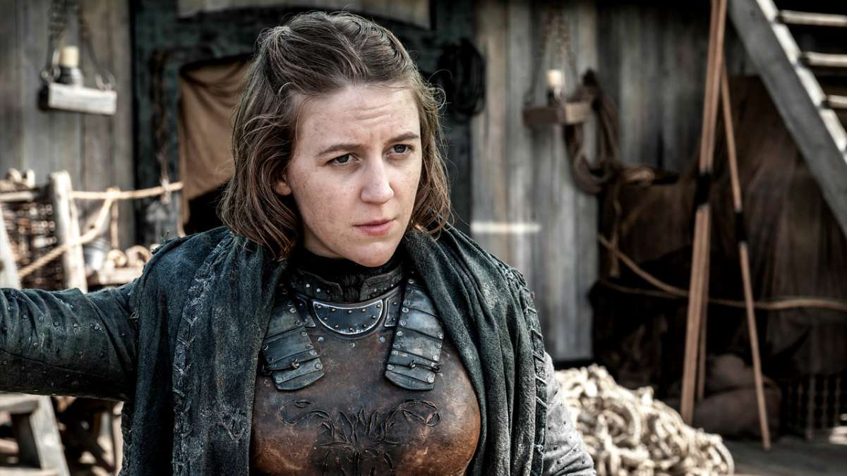
Summary of Marques (2019)
Three female characters—Brienne, Arya, and Yara—subvert in-milieu femininity.
They achieve power through masculinization.
Women appear to be taking power in Westeros.
Figure 1: Brienne of Tarth (Home Box Office, 2019).
Figure 2: Arya Stark (Home Box Office, 2019).
Figure 3: Yara Greyjoy (Home Box Office, 2019).

Slide 4
Pathos and Logos in Marques (2019)
Pathos
  Pop-culture invocations
  Yara is “like a true captain” (p. 57)
Logos
  Article structure is inductive reasoning (i.e., a few samples lead to a general conclusion)
  Causal reasoning throughout (i.e., Æ causes Ð, which causes Þ, so Æ brings about Þ)

Slide 5
Ethos in Marques (2019)
Primary sourcing
  13 episodes cited among 31 references entries (pp. 63-65)
Secondary and critical sourcing…maybe too much?

Slide 6
A Counterargument to Marques (2019)
Marques (2019) asserts that “women are taking over Westeros” (p. 46).
Bran becomes king.
  Carroll (2019) notes a relative lack of narrative justification
Danerys is undercut after doing the same thing audiences have cheered throughout (Carroll, 2019)

Slide 7
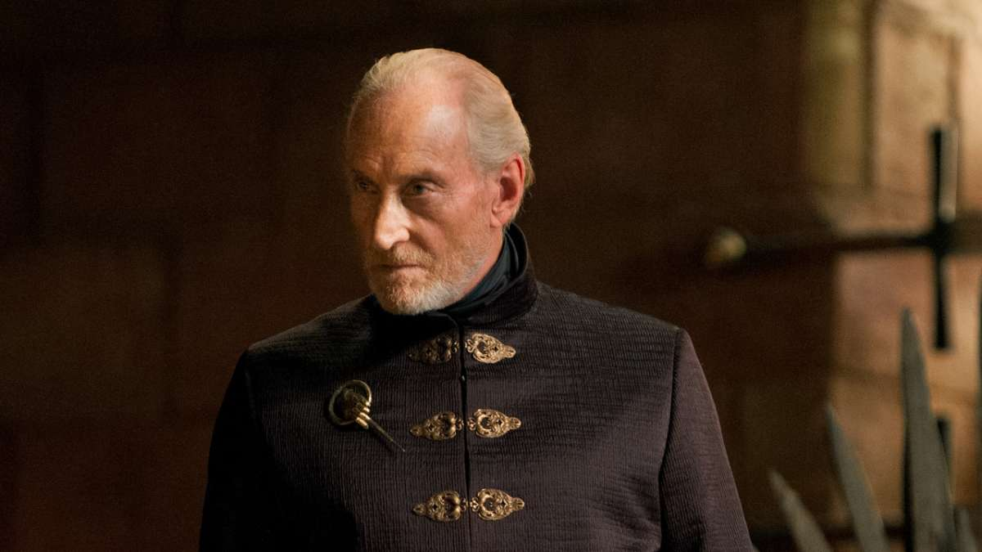
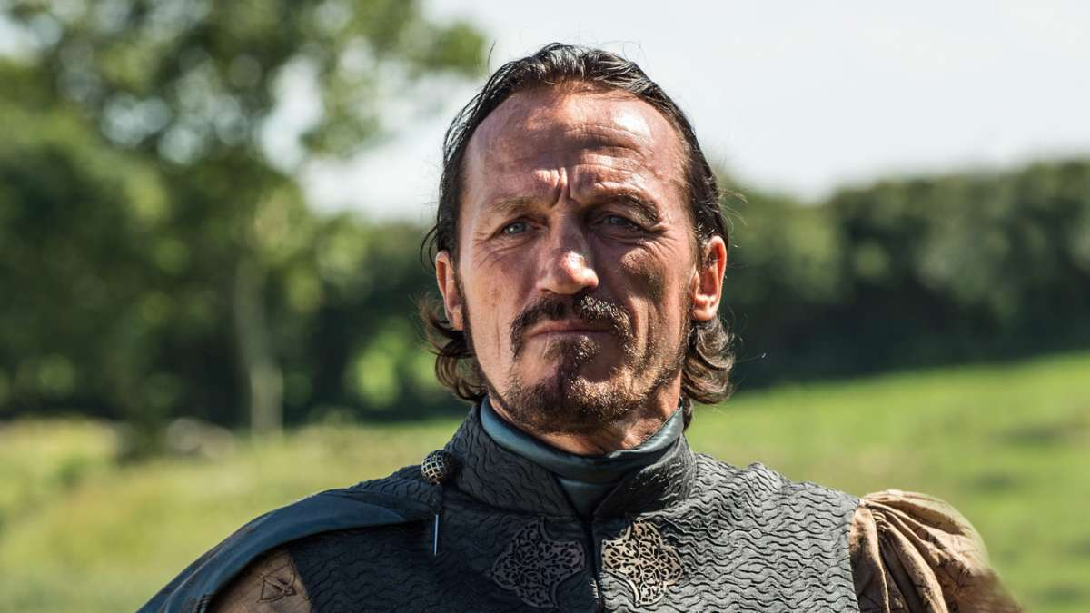
Another Counterargument to Marques (2019)
What is masculinity, anyway?
  Emphatically not austerity of dress
Not having a stable rubric makes
assessments difficult, at best—
and no such standard is on offer
Figure 4: Tywin Lannister
(Home Box Office, 2019).
Figure 5: Bronn (Home Box Office, 2019).

Slide 8
Hopeful Implications of Marques (2019)
The focal characters do move away from in-milieu expectations of femininity.
The series is not, strictly, medieval.
  Sturtevant (2018) notes popular reliance on entertainment media for historical understanding.
  Series sources are flawed (Finn, 2019).

Slide 9
Conclusion
Celebrate what is good and right.
Combat what is wrong.
  Pop culture gets a lot wrong.
  What it gets wrong is seized upon by execrable people who deserve all opprobrium.
  Take away their support and heap scorn upon them, always.

Slide 10
References
Carroll, S. (2019, 20 May). Game of thrones watch: 8.6 The iron throne. [web log post]. Retrieved from https://talesaftertolkien.blogspot.com/2019/05/game-of-thrones-watch-86-iron-throne.html
Finn, K. M. (2019, 16 May). Game of thrones is based in history—Outdated history. Retrieved from https://www.publicmedievalist.com/thrones-outdated-history/
Home Box Office. (2019). Game of thrones – Official website. Retrieved from https://www.hbo.com/game-of-thrones.
Marques, D. (2019). Power and the denial of femininity in Game of thrones. Canadian Review of American Studies / Revue Canadienne d’Études Américaines 49(1), 46-65. doi: 10.3138/cras.49.1.004
Sturtevant, P. (2018). The middle ages in popular imagination: Memory, film, and medievalism. London, UK: Bloomsbury Academic.

